Slide 1

Hospitality Analytics For Shodwe Hotels
Group No. 2
Sarika Bagal
Gaurav Bhosale
Krunal Malewar
Charansai Goli
Mamta Dhadave
Simran Panchal
Ravi Teja

Slide 2
Agenda
Excel Dashboards
Introduction
Power BI Dashboard
Project Overview
Tableau Dashboard
KPI – Key Performance Indicator
SQL Queries
Tools & technology
Summary

Slide 3




Introduction
The hospitality industry is highly data-driven, where business performance depends on effective analysis of bookings, revenue, occupancy, and customer behavior. This Hospitality Analytics Project focuses on analyzing hotel booking data to uncover meaningful insights that support data-driven decision-making.
The analysis helps identify key performance indicators such as Total Bookings, Revenue, Occupancy Rate, Cancellation Rate, and Discounts, enabling stakeholders to monitor operational performance effectively.
The dashboards provide insights into revenue trends, city-wise and property-wise performance, room category utilization, and cancellation impact, helping hotel management optimize pricing strategies, improve occupancy, and reduce revenue loss.

Slide 4

Project Overview
End-to-end hospitality analytics project
Tools used :- Power BI, Tableau, Excel, SQL
Focus on Booking, Revenues, Cancellation and Occupancy.

Slide 5




KPI's – Key Performance Indicator
Bookings
Revenue
This KPI helps measure overall demand, track booking trends, and understand customer interest across cities, properties, and room categories.
It is a key metric for evaluating financial performance, identifying high-revenue locations, and analyzing the impact of pricing and discounts.
Occupancy
Cancellation
It is crucial for evaluating capacity utilization, optimizing room inventory, and improving operational efficiency.
This KPI helps identify revenue leakage, assess booking reliability, and understand customer behavior patterns affecting business stability.

Slide 6




Tools & Technologies
Power BI :- Interactive Dashboards
Tableau :- Visual storytelling Dashboards
SQL :- Data extraction and transformation
Excel :- Data validation and preprocessing

Slide 7
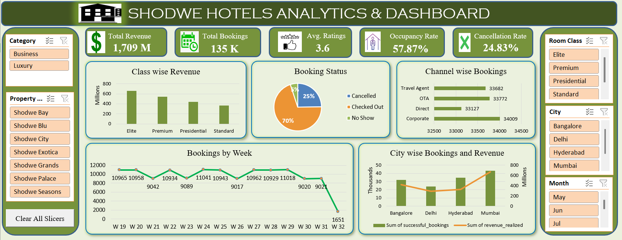
Excel Dashboard

Slide 8
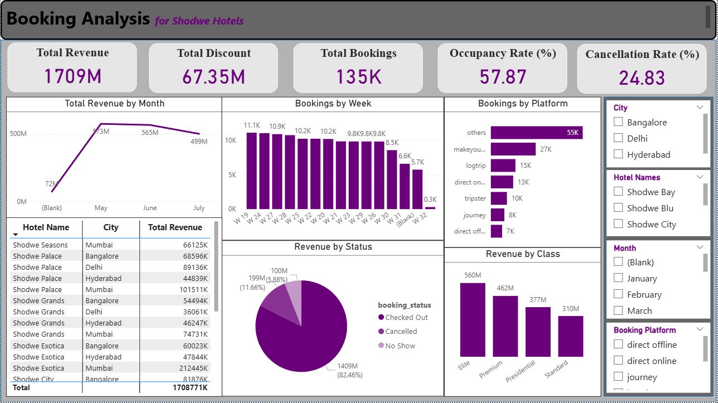
Power BI Dashboard

Slide 9
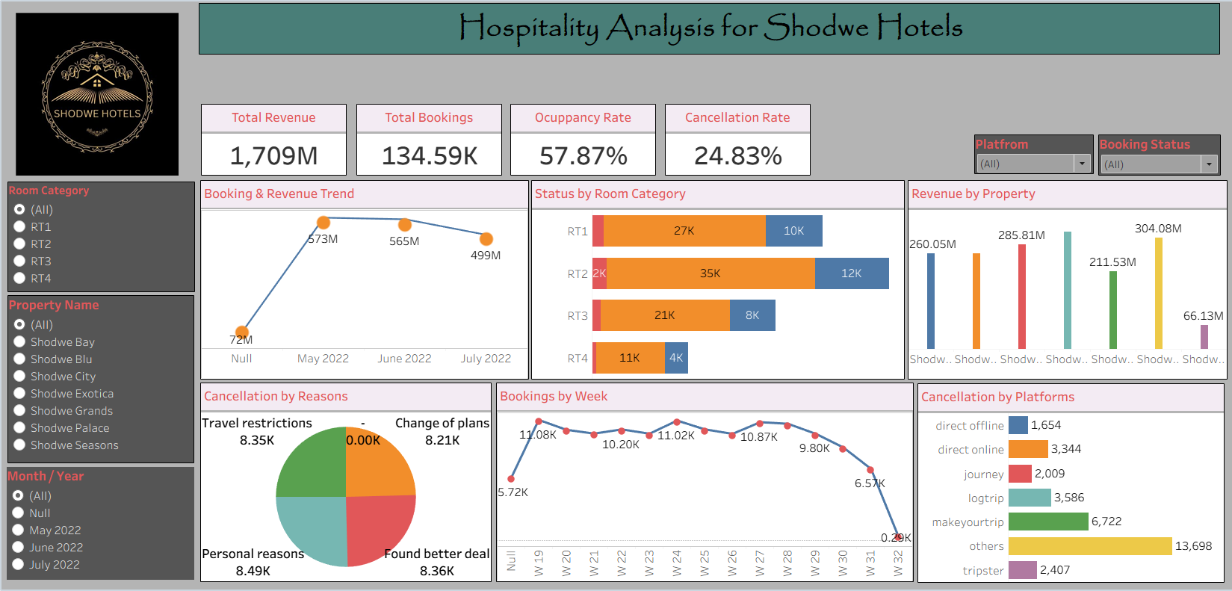
Tableau Dashboard

Slide 10
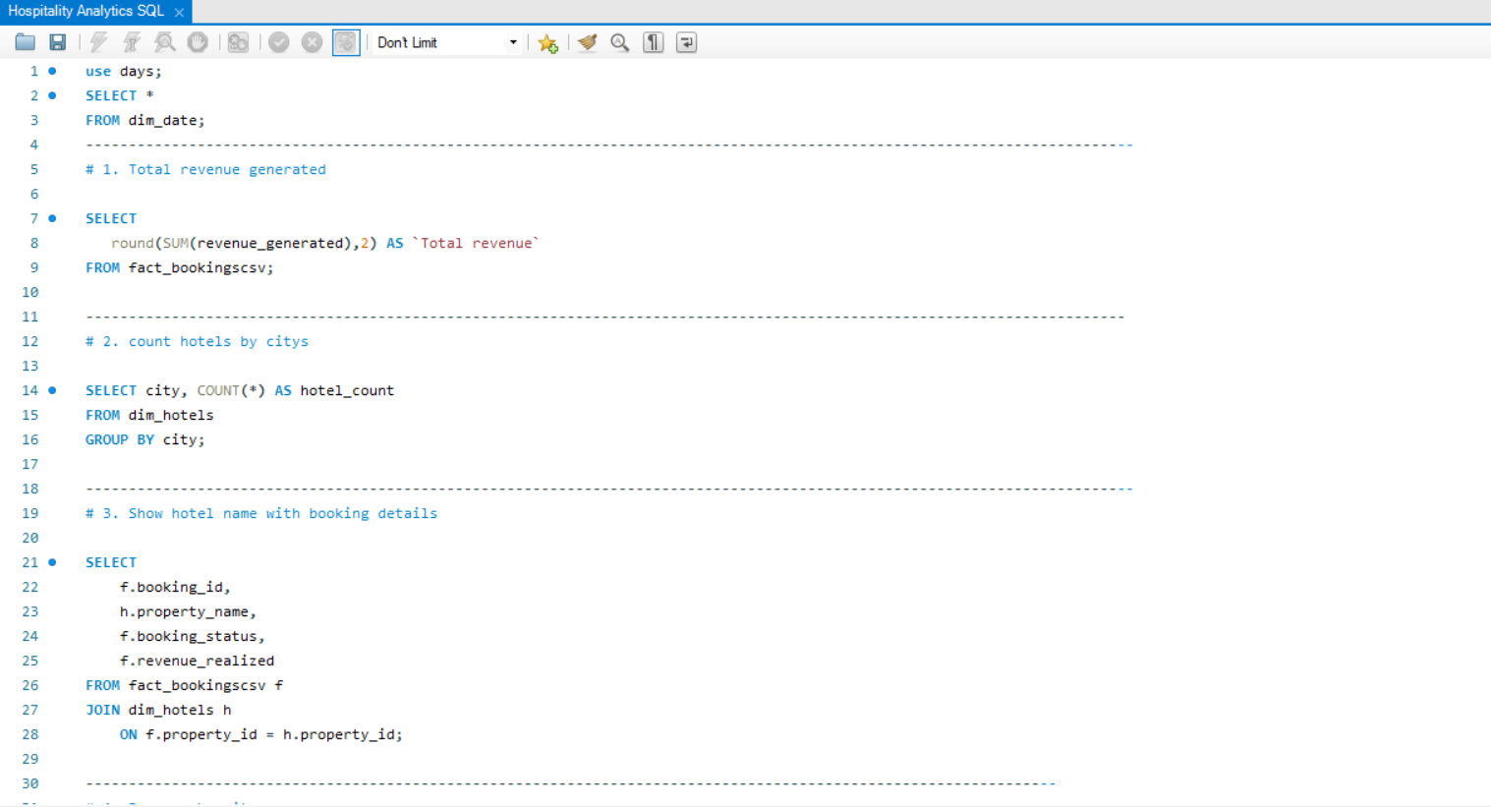
SQL Queries

Slide 11
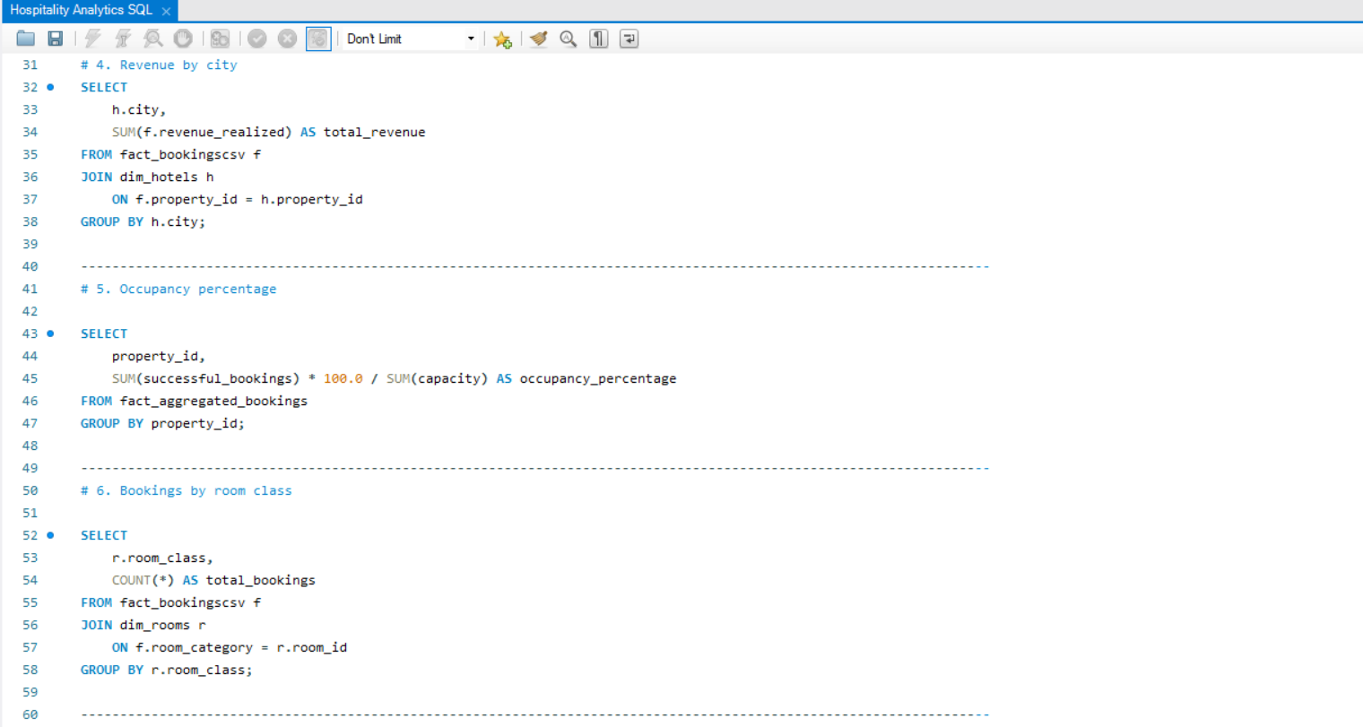
SQL Queries

Slide 12
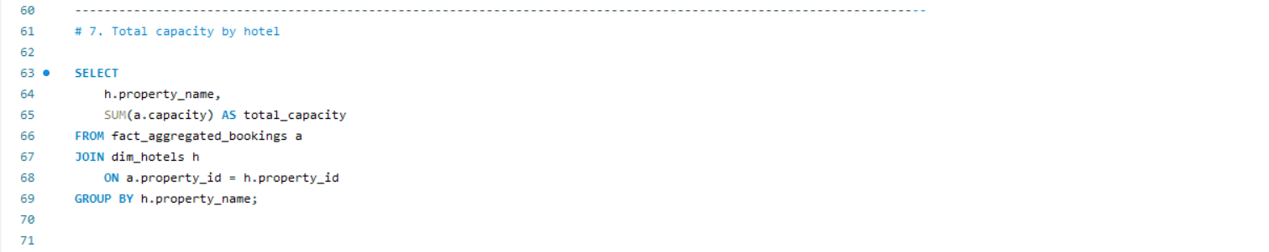
SQL Queries

Slide 13




Project Summary
Booking & Revenue :- The project analyze overall Booking and Revenue using Fact bookings excel dataset to evaluate Business growth.
KPI's Analysis :- Used SQL & DAX to calculate key metrics such as Total Bookings, Total Revenue, Occupancy Rate, Cancellation Rate and Average Rate.
Customer & Regional Insights :- Analyzed city-wise and property-wise revenue performance to identify top and underperforming locations. Rating given by customers that also helps in performance of hotels.
Rooms & Cancellation Trend :- Evaluated room category performance to understand demand and optimize inventory utilization. Studied cancellation patterns to assess revenue loss and improve booking reliability.

Slide 14
Conclusion
Successfully analyzed hotel booking data to gain insights into bookings, revenue, occupancy, and cancellations.
Built an end-to-end analytics solution using SQL, Excel, Power BI, and Tableau.
Highlighted cancellation patterns and their impact on overall revenue.
Enabled interactive analysis through dynamic dashboards and slicers.
Provided actionable insights to support pricing optimization, revenue growth, and operational efficiency.
Demonstrated strong data analytics skills aligned with real-world hospitality business requirements.

Slide 15

Thank you

